Slide 1
A UK Perspective
Adrian Wooster

Slide 2
In the beginning
Seeds of investment started to appear
The pioneers were often by necessity challenging characters
Operators were often disorganised, small scale and tactical
Some challenging early failures
All public investment went to the safe option for largely incremental upgrades
Few institutional investments

Slide 3
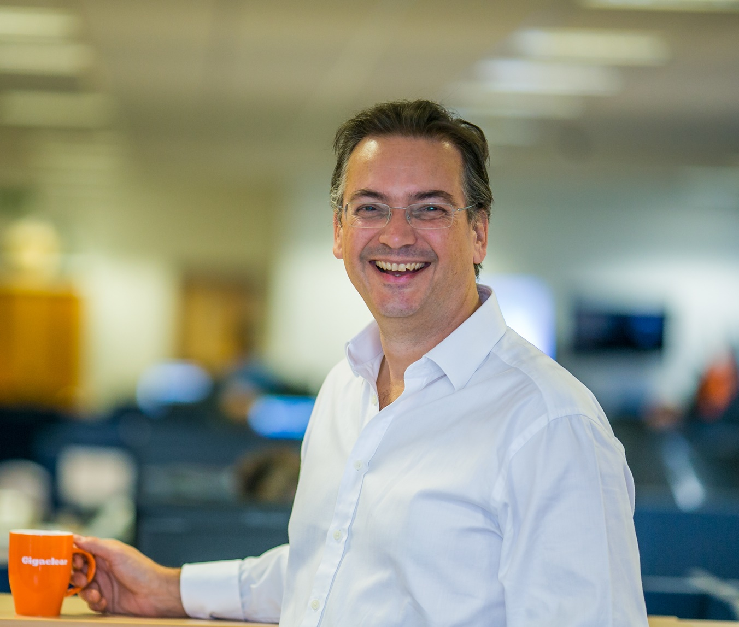
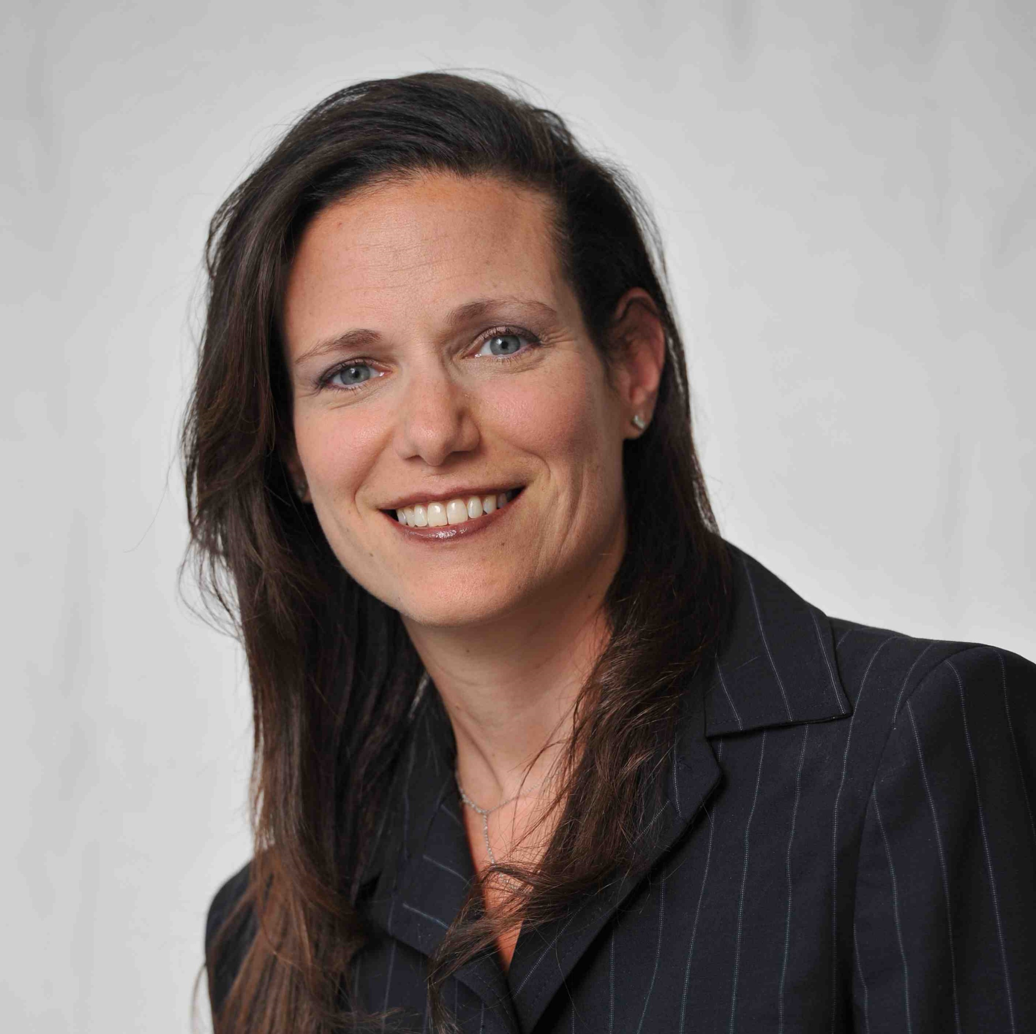
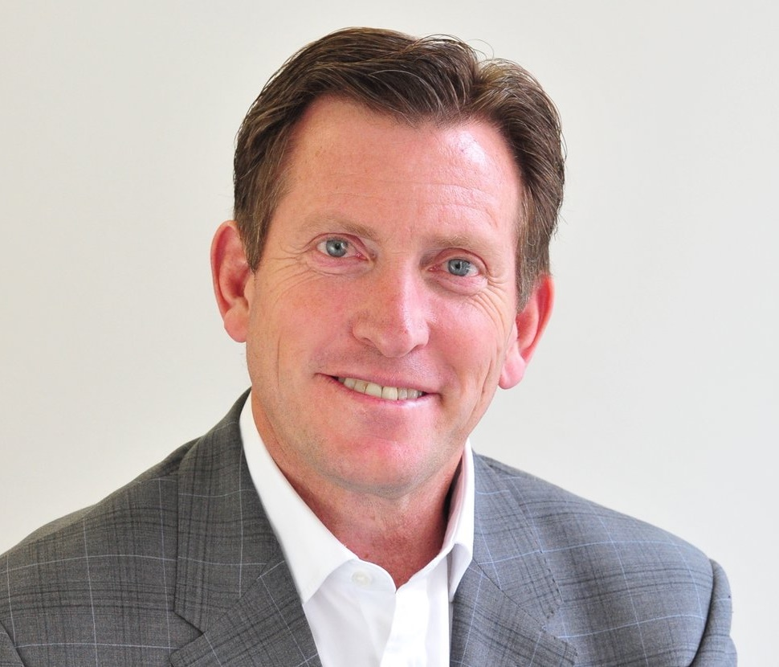
The Challengers
The rise of the big 3
Cityfibre
Hyperoptic
Gigaclear
The principle that FTTH was possible and could be done by someone other than BT became indisputable

Slide 4
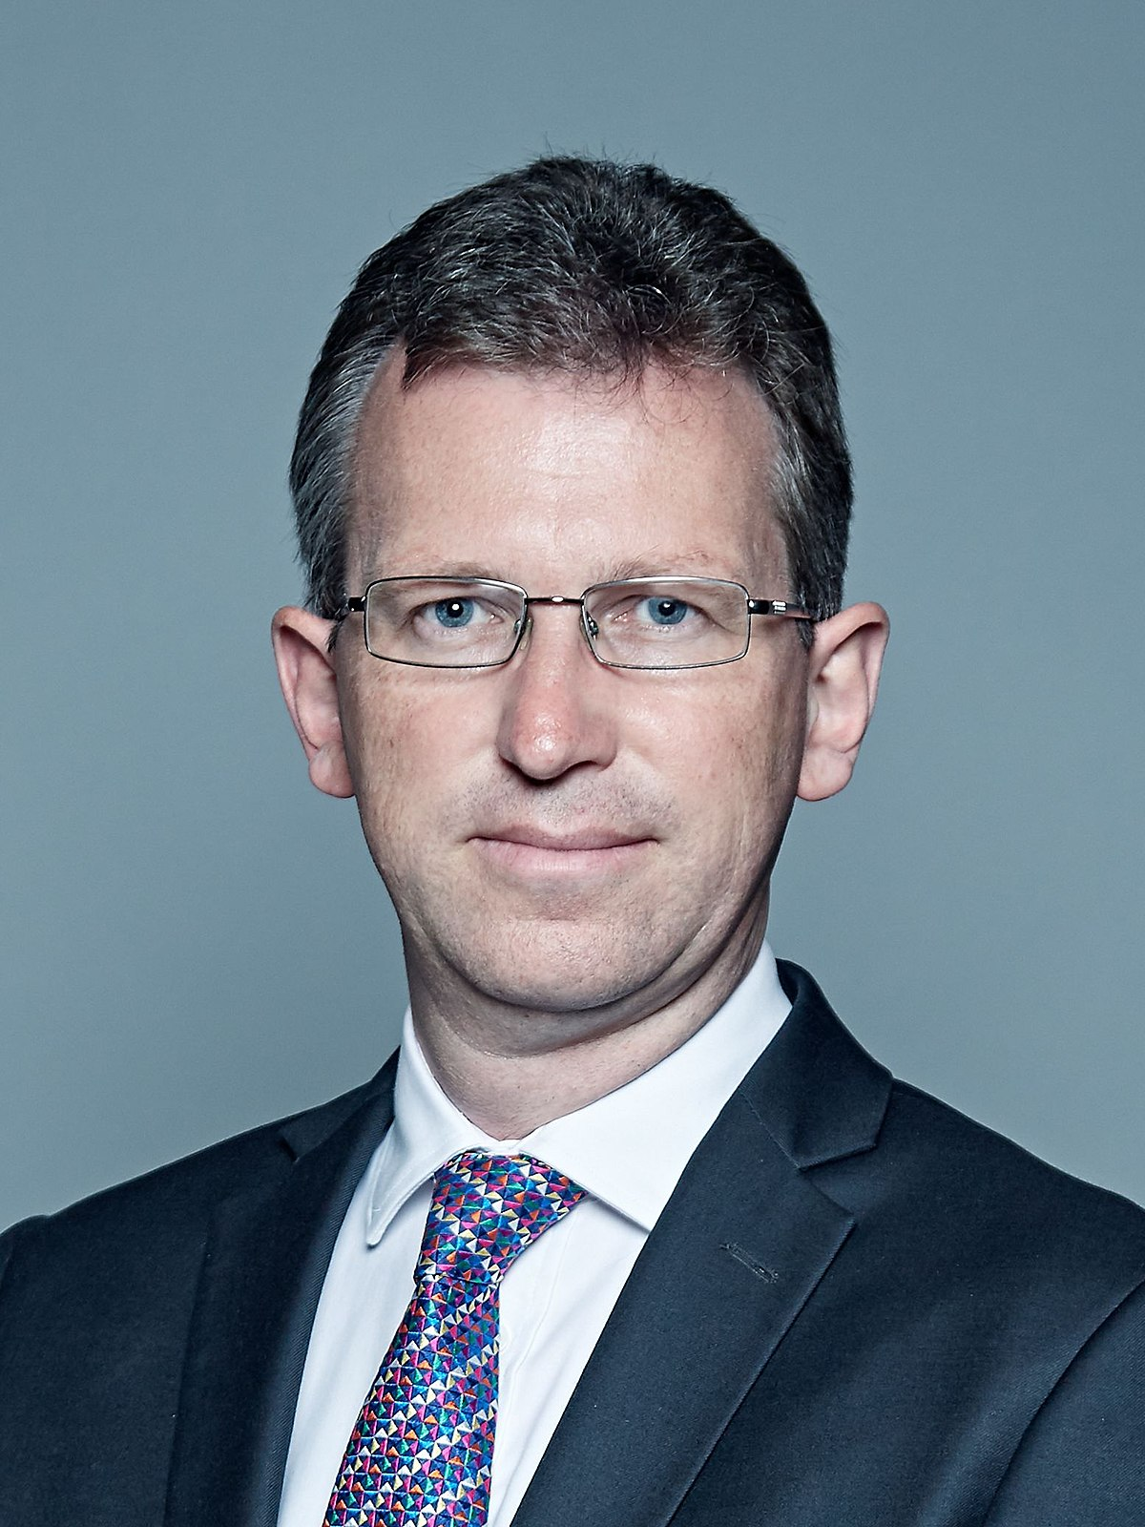
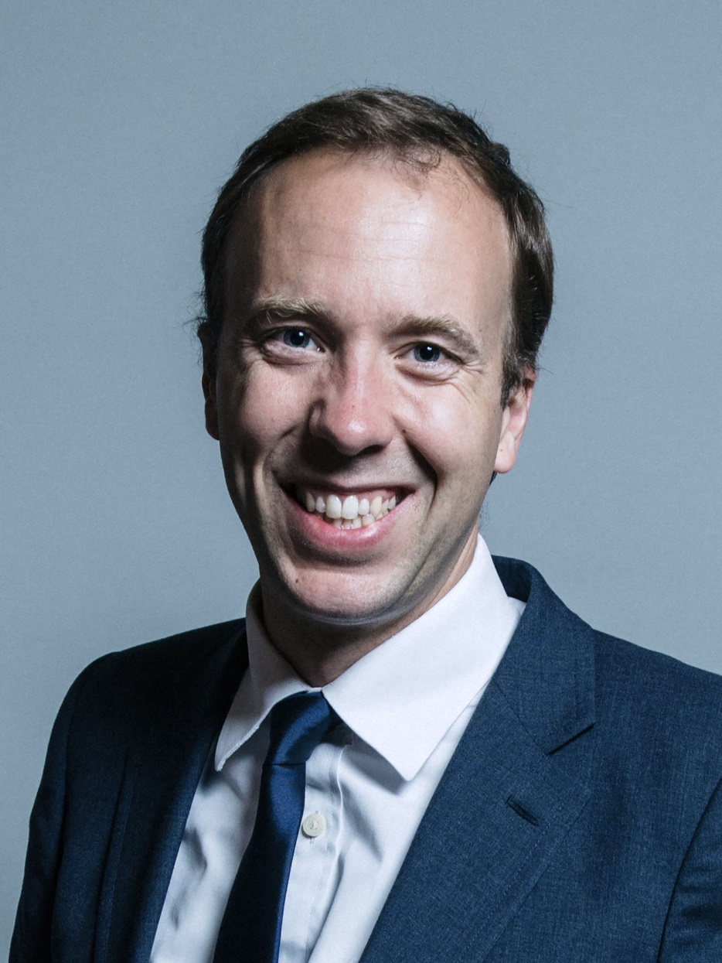
More than a vision
Vision – “I agree: fibre is the future”*
Strategy – “Future Telecoms Infrastructure Review”
An opportunity to redefine the market for fibre & 5G
Reconsider structural difficulties delivering full fibre
“Outside-in” £3-5bn funding for full-fibre only
Tactical
Barrier Busting
Wayleaves
Highways & noticing
Broadband Universal Service Obligation
PSTN switch-off, All-IP & Battery Back-up
European Electronic Communications Code
New Build planning proposals
“Statement of Strategic Priorities”
Matt Hancock
Jeremy Wright
* Rt Hon Matt Hancock, Broadband World Forum, 2017
Notes:
Jeremy Wright is giving all the right signals that he will continue this work

Slide 5
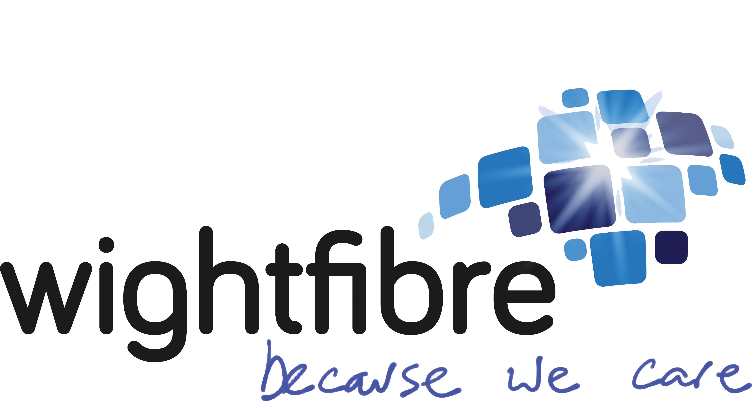
Ultrafast Broadband Market
Urban
Suburban & Market Town
Rural
Niche
Notes:
And TalkTalk

Slide 6
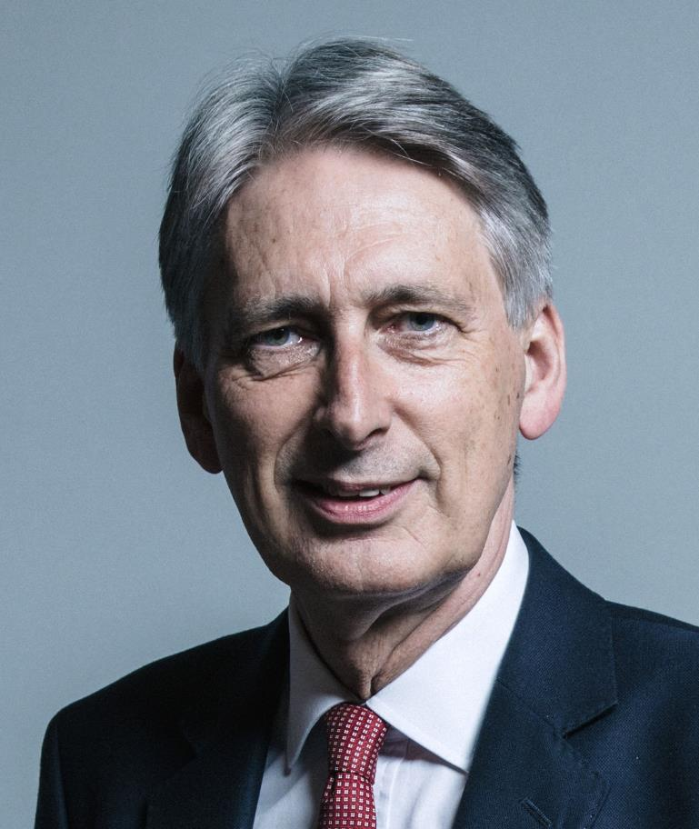
Running both copper and fibre networks indefinitely will not benefit either the consumer or the industry… …so we must start thinking now about that switchover […] to move customers away from copper and on to fibre
“
Philip Hammond, Chancellor’s speech: CBI Annual Dinner 2018

Slide 7
Three full-fibre markets?
Public Intervention
Ofcom
1 - Dense Urban
Stimulating Private Investment
Multiple operators -
Increasingly unregulated
2 – Suburban & Market Towns
Stimulating Private Investment
Competition possible – watching brief
3 - Low Density Rural
Subsidized Open Networks
Natural Monopoly

Slide 8
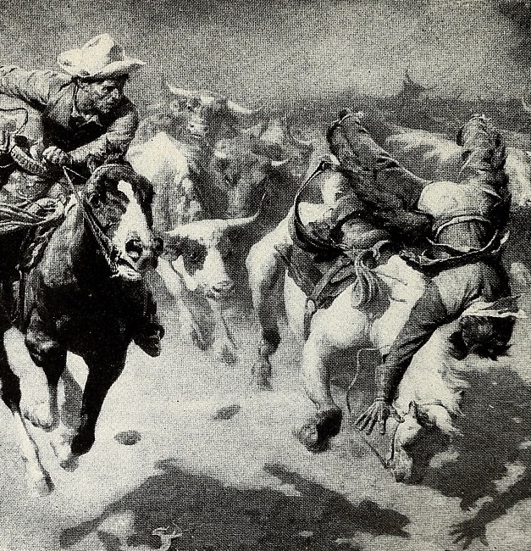
A stampede?
The UK is now investing in fibre
The copper switch-off is under consideration so churn is now fairly certain
Risk?
Small number of established companies to invest in
Small operators being offered more than they ask for, with funds sometimes structured badly
Investors need to better understand the sector
Now is the right time to invest in UK fibre

Slide 9
Thank you!
Nico Grove Nicco.grove@di-square.eu
0049 (0) 178 811 8166
Thomas Langer Thomas.Langer@di-square.eu
0049 (0) 173 531 3450

